Slide 1
Energy Networks Association
ENA EREC G69 Issue 5 2026
Revision Summary
15th April 2026

Slide 2
ENA EREC G69 Issue 5 2026 Revision Summary
Guidance on working with insulation and interruption gases (IIG) used in electrical power equipment
DOCUMENT PURPOSE
To collate key requirements, guidance and best practice for working with insulation and interruption gases (IIG) for use in electric power equipment. This includes pure IIG and IIG mixtures
SCOPE
Background on use of IIGs in electric power equipment.
UK and European legislation relating to use of IIGs
Properties of different types of IIGs covered by EREC.
Impact of IIGs on the environment.
Toxicology and hazards of IIGs.
Guidance on storage, transport and handling procedures for IIGs used in electric power equipment.
HISTORY
Issue No. | Date | Details of revision.
1st Issue | 2005 | First Issue.
Issue 2 | 2012 | Updated after publication of F-Gas Regs 2009.
Issue 3 | 2013 | Minor revision to incorporate information from EREC G72.
Issue 3 + Amdt. 1 | 2016 | Updated due to introduction of F-Gas Regs 2015 and new Ofgem reporting requirements.
Issue 4 | 2022 | Major update to include wider range of IIGs, changes to legislation, Ofgem requirements and revision BS EN IEC 62271-4.
2

Slide 3
ENA EREC G69 Issue 5 2026 Revision Summary
Summary of Amendments
Title of document changed from:
“Guidance on working with Insulation and Interruption Gas (IIG) and gas mixtures in high voltage switchgear of rated voltage up to and including 145 kV” to..
“Guidance on working with insulation and interruption gases (IIG) used in electric power equipment”
This reflects terminology used in BS EN IEC 62271-4
Updated references to Standards, legislation and other manufacturer guidance documents that been issued since Issue 4:
EU F-Gas Regulations 2024. These regulations are presently not adopted in GB but are considered as best practice by parties such as Ofgem
Ofgem Greenhouse Gas (GHG) revised reporting requirements for ENA Member Companies under recent Price Review settlements
Nature of Revision
Major
Key Points
EU F-Gas Regs 2024 lays down dates for ban of use of F-gases in electrical power equipment depending on voltage range
These Regs not adopted by GB under F-Gas EU Exit Regulations 2021 but apply to Northern Ireland
Ofgem now require reporting on all IIGs with GWP >0
3

Slide 4
ENA EREC G69 Issue 5 2026 Revision Summary
Summary of Amendments
Publication of BS EN IEC 63360, which specifies the quality of alternative gases to SF₆ for use in electrical power equipment, including:
Compressed air
Synthetic air
Natural-origin gases
C5-FK (C₅F₁₀O) Fluoroketone gas mixtures
C4-FN (C4F7N) Fluoronitrile gas mixtures
Draft BS EN IEC 63359:
Specifies the quality of above alternative gases to SF₆ for their re-use in electric power equipment after recovery
At CDV stage at time of revision of Issue 5 of EREC G69. Expected to be issued in 2026
Nature of Revision
Major
Key Points
These Standards specify the quality of IIGs for use in electric power equipment
Concentration level
Maximum moisture content
Impurities
Requirements now incorporated into Issue 5 or EREC G69
4

Slide 5
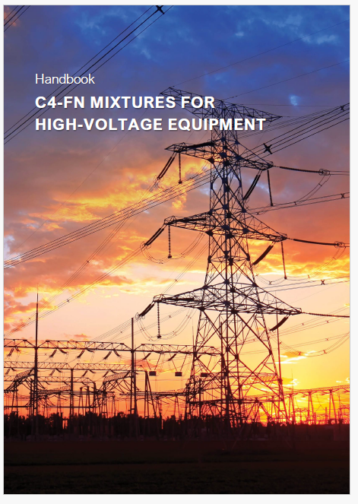




ENA EREC G69 Issue 5 2026 Revision Summary
Summary of Amendments
Sections covering C4-FN mixtures have been revised to provide more information on the use and handling of C4-FN mixtures
Protection against asphyxiation
Precautions to prevent exposure to solid-by products in C4-FN mixtures
Precautions to prevent exposure to C4-FN
Precautions to prevent exposure to CO
Nature of Revision
Major
Key Points
Some specialist PPE is required when working with non-arced C4-FN mixtures
May contain Fluoro-amide crystals which are toxic when ingested but will also cause eye and skin irritation
Maximum levels for exposure to C4-FN mixtures specified
Different PPE recommended for different work activities
5

Slide 6
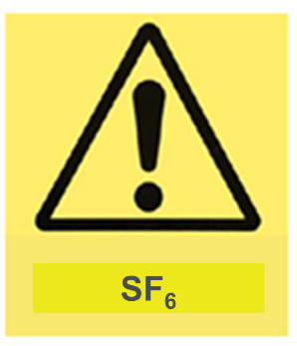




ENA EREC G69 Issue 5 2026 Revision Summary
Summary of Amendments
Guidance now provided on notices to be posted at substations containing IIGs:
Nature of Revision
Major
Key Points
For member companies who already display SF₆ notices at sites:
New notices recommended
For natural-origin gases with O₂ < 19.5%
Recommended notices also for sites with C4-FN or C5-FK nixtures
6

Slide 7
ENA EREC G69 Issue 5 2026 Revision Summary
Who is affected and why?
Primarily, staff and contractors, who are tasked with handling of IIG in electric power equipment (mainly in HV switchgear) during gas recovery, gas filling and topping up of gas -New procedures now required for C4-FN mixtures.
Operational staff who operate switchgear (particularly precautions to be taken in event of a large loss of IIG or an internal arcing fault) – Staff need to be aware of possible hazards and procedures /PPE to be implemented. Also steps needed to avoid leakage of some IIGs to the environment.
Staff involved in the transport of electric power equipment containing IIG- Need to be aware of maximum thresholds before special transport measures are needed.
Staff involved in the storage of IIG in containers and cylinders- procedures for checking leakage and preventing leakages
7

Slide 8
ENA EREC G69 Issue 5 2026 Revision Summary
Impact Assessment
 | Rating | Assessment
Safety | Major | Additional guidance on handling of gases needed.
Environment | Major | Alternative IIGs with lower GWPs compared to SF₆ now covered but leakage of some IIGs (e.g. C4-FN) still need to be avoided.
Financial (costs/benefits) | Medium | Significant training costs and new IIG handling equipment may be required.
Asset Quality & Performance | Medium | Failure to comply with quality requirements of IIG may lead to reduced asset life or failure of asset in service.
Statutory/ Regulatory | Medium | Changes to statutory requirements for use of IIGs in Northern Ireland (likely to be introduced into GB in near future).
Reputation | Major | Failure to comply with the requirements specified in this EREC can lead to loss of IIG to the atmosphere with risk of significant impact on reputation.
8

Slide 9
ENA EREC G69 Issue 5 2026 Revision Summary
Summary and Actions
ENA EREC G69 Issue 5 2026 is a major revision of Issue 4
ENA Member Companies may to review their relevant documentation and operating procedures for handling of IIG in electric power equipment
The document is available from the ENA Engineering Catalogue at: www.energynetworks.org.
9

Slide 10
© ENA 2026
10

